Slide 1


16th Century –The Renaissance-The Tudor Period
The House of Lancaster
The House of York

Slide 2
16th century political and social background
In 1485, the struggles between the two great feudal houses in England, the House of Lancaster and the House of York ended with the defeat of Richard III, and the first Tudor King, Henry VII came to the throne. These struggles are known as the Wars of The Roses

Slide 3
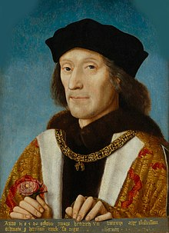
The defeat of Richard III
The first Tudor king, Henry VII

Slide 4
In 1492 Columbus discovered America and in 1495 Vasco de Gama reached the Orient sailing around the Cape of Good Hope.
William Caxton set up the first printing press in London

Slide 5
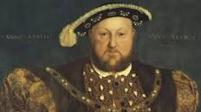
Henry VIII (1509-1547)

Slide 6
The reign of Henry VIII saw the reformation and the beginning of the Renaissance

Slide 7
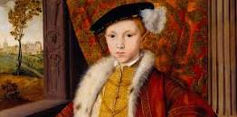

Slide 8
The short reign of Edward VI witnessed the growth of Protestantism in England

Slide 9
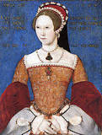
Mary Tudor

Slide 10
The successor to the young Protestant King was his elder sister Mary Tudor. She was a Catholic. She married a Spanish king. She persecuted the Protestant and put many of them to death.

Slide 11
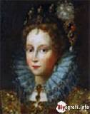
Elizabeth I

Slide 12
Elizabeth I ruled until 1603. When she became queen, through her political talent first united England, gave the people a very real feeling of nationality. She was excommunicated by the Pope. Her excommunication brought English people round their queen. She defeated Spanish Armada.
During reign of Elizabeth I, the influences of Italian renaissance were felt in England.

Slide 13
Literature of the Period (Renaissance)
The characteristic of this period is a rejection of medieval learning for classical learning. The most important achievement in culture is its attempt to harmonize the Christian tradition, culture with classical culture, and to lead to a new interpretation of Christianity.

Slide 14
Humanism in the Renaissance sense means the study of classical culture and literature. It’s the study of the works dealing with the life and thought, of the language and literature of the ancient Greeks and Romans

